Slide 1


Morphy Yeboah
9/18/2023

Slide 2

Outline
Executive Summary
Introduction
Methodology
Results
Conclusion
Appendix

Slide 3
Executive Summary
In the adopted methodology, data was sourced from both the public SpaceX API and the SpaceX Wikipedia page. A 'class' column was introduced to categorize successful landings, followed by an extensive data exploration phase. This exploration encompassed SQL queries, the utilization of data visualization techniques, the integration of Folium maps for geographical analysis, and the independent creation of interactive dashboards.
To prepare the data for machine learning, a careful selection of the most relevant columns as features was undertaken. The conversion of categorical variables into binary format via one-hot encoding was independently executed, ensuring their suitability for modeling purposes. Additionally, independent standardization procedures were implemented to maintain data uniformity and comparability.
In the machine learning phase, the GridSearchCV technique was employed to autonomously fine-tune hyperparameters, thereby enhancing model performance. To effectively communicate the results, independent efforts were directed towards creating visualizations that effectively illustrate the accuracy scores of all models, facilitating performance comparisons and informed decision-making.
In the analysis of various machine learning models, Logistic Regression achieved the highest test data accuracy at 94.44%, showcasing the effectiveness of this model in classifying successful landings. The Support Vector Machine (SVM), Decision Tree Classifier, and K-Nearest Neighbors (KNN) models all demonstrated an accuracy of 83.33% on the test dataset. Overall, Logistic Regression outperformed the other models, making it the preferred choice for this classification task.

Slide 4
Introduction
SpaceX, a prominent aerospace manufacturer and space transportation company, offers Falcon 9 rocket launches at a significantly lower cost of 62 million dollars, compared to other providers that charge upwards of 165 million dollars for each launch. The key to these cost savings lies in SpaceX's ability to reuse the first stage of the rocket. Therefore, the success or failure of the first stage landing is of utmost importance in determining the overall cost of a launch.
The project's context revolves around the idea that by accurately predicting the first stage's landing outcome, one can estimate the cost of a Falcon 9 rocket launch. This information holds strategic value, especially when other companies are considering bidding against SpaceX for rocket launch contracts. By providing insights into the likelihood of a successful landing, this project aims to empower decision-makers and potential competitors in the space launch industry with valuable cost-related information.
Predicting whether the first stage will land successfully, this project seeks to provide insights into the overall cost of a Falcon 9 launch.

Slide 5

Section 1

Slide 6
Methodology
Executive Summary
Data collection methodology:
Data is collected from two primary sources: the public SpaceX API and the SpaceX Wikipedia page.
Perform data wrangling
The "Class" column was created as the target variable, representing whether the first stage landing was successful or not. It was assigned a value of 0 for unsuccessful landings (based on "bad_outcomes") and 1 for successful landings.
Perform exploratory data analysis (EDA) using visualization and SQL
Perform interactive visual analytics using Folium and Plotly Dash
Perform predictive analysis using classification models
GridSearchCV technique was utilized to fine-tune hyperparameters

Slide 7
Data Collection
Utilize the SpaceX API to programmatically retrieve data related to Falcon 9 rocket launches. This data may include details about launch outcomes, mission success, and other relevant information.
Extract additional information from the SpaceX Wikipedia page using web scraping techniques. This data may complement the API data and provide a more comprehensive dataset for analysis.
Combine and integrate data obtained from both sources into a single dataset. Ensure that the data is in a consistent and structured format for analysis.

Slide 8
Data Collection – SpaceX API
GitHub URL
IBM-Data-Science-Capstone-Project/Data Collection and Wrangling/jupyter-labs-spacex-data-collection-api.ipynb at main · Morphy-Yeboah/IBM-Data-Science-Capstone-Project (github.com)
requests.get(spacex_url)
Filter dataframe to only include Falcon 9
Replace missing values from the PayloadMass column the with the mean
Get helper function(i.e getBoosterVersion, etc)
Combine column in dictionary and create a dataframe from it
Decode with .json(), turn to dataframe with .json_normalize()

Slide 9
Data Collection - Scraping
GitHub URL
IBM-Data-Science-Capstone-Project/Data Collection and Wrangling/jupyter-labs-webscraping.ipynb at main · Morphy-Yeboah/IBM-Data-Science-Capstone-Project (github.com)
Request Falcon9 wiki html
Create dataframe from the dictionary
Create beautifulsoup object from html
Extract launch records to fill dictionary
Use find_all to find table header with column names
Create dictionary with relevant column names

Slide 10
Data Wrangling
A set of "bad outcomes" was identified where the second stage did not land successfully, including outcomes like "False ASDS," "False Ocean," "False RTLS," "None ASDS," and "None None.“
A new label, "Class," was created to represent the outcome of each launch. If the outcome is in the set of "bad outcomes," a value of 0 was assigned; otherwise, it received a value of 1. This label indicates whether the first stage landed successfully (1) or not (0).
The data processing steps included handling missing values in the "LandingPad" column by creating a new classification label, "Class," based on the mission outcome.
The "Class" label represents the success or failure of the first stage landing.
The success rate was found to be approximately 0.667, indicating that about 66.7% of launches had successful first stage landings.
GitHub URL
IBM-Data-Science-Capstone-Project/Data Collection and Wrangling/IBM-DS0321EN-SkillsNetwork_labs_module_1_L3_labs-jupyter-spacex-data_wrangling_jupyterlite.jupyterlite.ipynb at main · Morphy-Yeboah/IBM-Data-Science-Capstone-Project (github.com)

Slide 11
EDA with Data Visualization
Charts Plotted
Scatter plots, line charts, and bar plots were created to explore the associations between variables, including Flight Number vs. Payload Mass, Flight Number vs. Launch Site, Payload Mass vs. Launch Site, Orbit vs. Success Rate, Flight Number vs. Orbit, Payload vs. Orbit, and the Success Yearly Trend.
These visualizations help explore the relationships between various factors (such as Flight Number, Payload Mass, Launch Site, Orbit Type, and Year) and the success or failure of SpaceX launches. They provide valuable insights for further analysis and feature engineering in the project
GitHub URL
IBM-Data-Science-Capstone-Project/EDA/IBM-DS0321EN-SkillsNetwork_labs_module_2_jupyter-labs-eda-dataviz.ipynb.jupyterlite.ipynb at main · Morphy-Yeboah/IBM-Data-Science-Capstone-Project (github.com)

Slide 12
EDA with SQL
Displayed unique launch site names.
Retrieved records of specific launch sites
Calculated the total payload mass carried by customers.
Calculated the average payload mass for booster versions.
Identified the first successful landing date, listed boosters for specific conditions, counted mission outcomes, found max payload carriers, and ranked landing outcomes within date ranges.
GitHub URL
IBM-Data-Science-Capstone-Project/EDA/jupyter-labs-eda-sql-coursera_sqllite.ipynb at main · Morphy-Yeboah/IBM-Data-Science-Capstone-Project (github.com)

Slide 13
Build an Interactive Map with Folium
Markers were added to represent launch sites and various points of interest, such as coastlines, highways, railways, and cities. Markers were color-coded to indicate the success or failure of launches from each site
Marker clusters were utilized to handle multiple markers with the same coordinates, improving map readability, especially when there were many launch records at the same location.
Polylines were drawn to connect the launch sites with specific points of interest, such as coastlines, highways, railways, and cities. These lines visually represented the distances between launch sites and these points.
Circles were used to highlight the launch sites on the map, providing a visual reference for the location of each launch site.
The MousePosition plugin was added to display the latitude and longitude coordinates when hovering over the map, facilitating the identification and recording of coordinates for various points of interest
By combining these map objects, an interactive map was created to visually represent launch site locations, launch outcomes, and distances to nearby geographical features. This map provided insights into the spatial relationships between launch sites and their proximities to coastlines, highways, railways, and cities
GitHub URL
IBM-Data-Science-Capstone-Project/Interactive_Dashboard/IBM-DS0321EN-SkillsNetwork_labs_module_3_lab_jupyter_launch_site_location.jupyterlite.ipynb at main · Morphy-Yeboah/IBM-Data-Science-Capstone-Project (github.com)

Slide 14
Build a Dashboard with Plotly Dash
The pie chart displays the percentage of successful launches and failures.
The scatter chart illustrates the correlation between payload mass and launch outcomes (success or failure).
Users can visualize how different payload masses affect launch success. The chart also distinguishes launches by Booster Version Category and can be filtered by launch site.
Selecting a launch site from the dropdown list updates the pie chart to display success vs. failures for that site.
Overall, these plots and interactions are added to make the dashboard user-friendly, informative, and interactive. They empower users to explore SpaceX launch data, make data-driven decisions, and gain a deeper understanding of the factors influencing launch success.
GitHub URL
IBM-Data-Science-Capstone-Project/Interactive_Dashboard/spacex_dash_app.py at main · Morphy-Yeboah/IBM-Data-Science-Capstone-Project (github.com)

Slide 15
Predictive Analysis (Classification)
IBM-Data-Science-Capstone-Project/Predictive-Analysis/IBM-DS0321EN-SkillsNetwork_labs_module_4_SpaceX_Machine_Learning_Prediction_Part_5.jupyterlite.ipynb at main · Morphy-Yeboah/IBM-Data-Science-Capstone-Project (github.com)
Create Numpy array from column “Class”
Build four models for logistic regression, SVM, decision tree, and KNN
Evaluate the models using test set
Standardize and transform the data
Visualize the accuracy of each model using a bar chart
Perform grid search with cross-validation to optimize hyperparameters
Split data into training and testing sets for model evaluation.

Slide 16
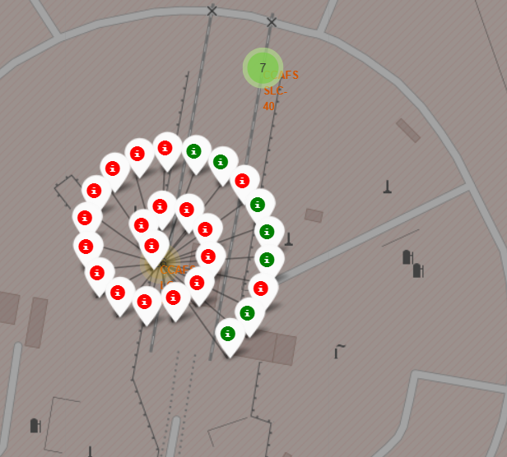
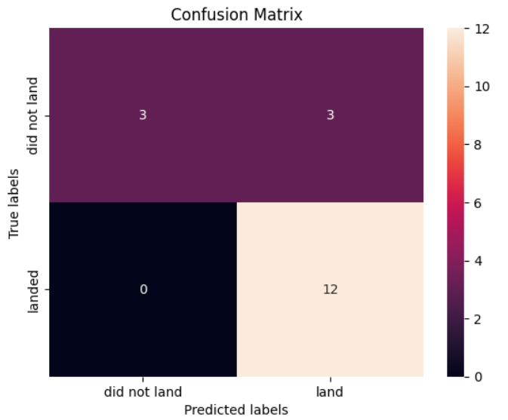
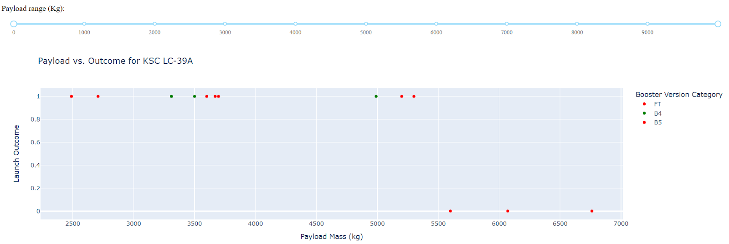
Results
To the right are Sample Results from EDA, Interactive Analytics demo, and Predictive Analysis

Slide 17

Section 2

Slide 18
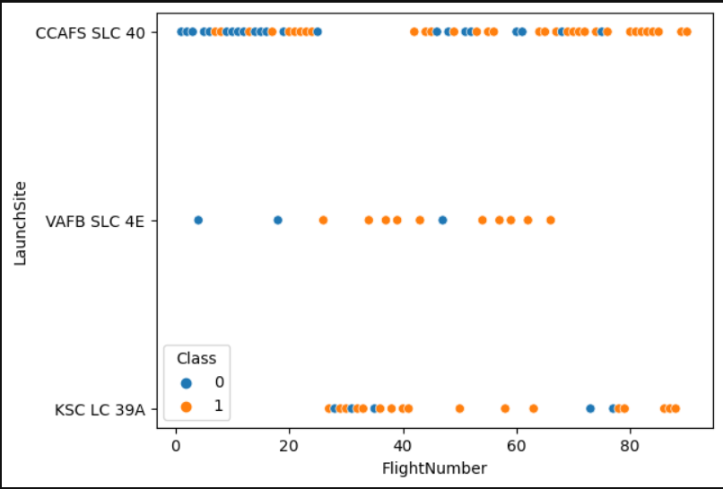
Flight Number vs. Launch Site
Blue bubbles represent “Class = 0” which is an unsuccessful launch. Orange bubbles represent “Class = 1” which is a successful launch
From the plot, we can observe that the flight numbers below 30 for “CCAFS SLC 40” launch site resulted mostly in bad outcomes whereas the larger flight numbers had mostly successful landing outcomes.

Slide 19
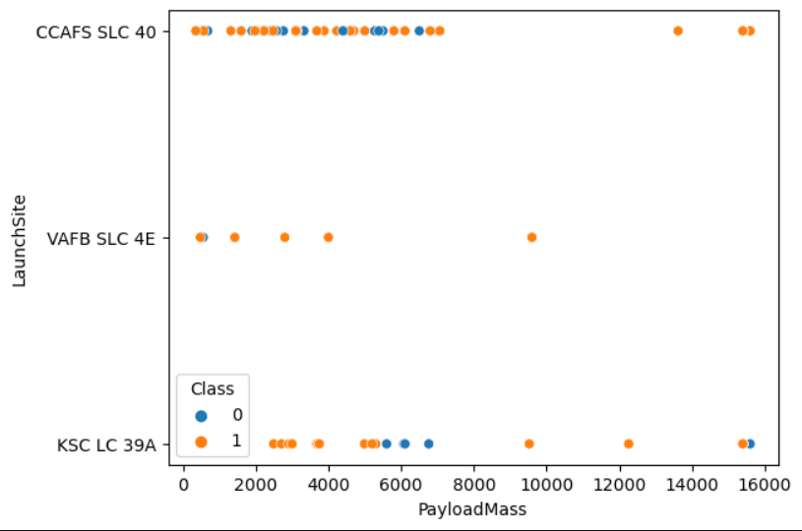
Payload vs. Launch Site
We observe that most rockets launched from all there sites have a pay load mass less than 8000
For the VAFB-SLC launchsite there are no rockets launched for heavypayload mass(greater than 10000) compared to other launch sites.

Slide 20
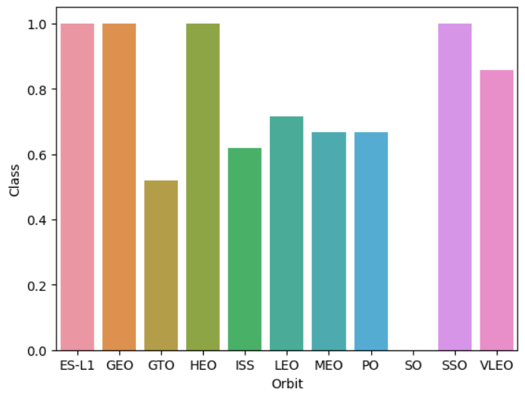
Success Rate vs. Orbit Type
Orbits with highest success rates are ES-L1, GEO, HEO, and SSO.
MEO and PO have the same success rate (>60%)
SO has the lowest success rate (0%)

Slide 21
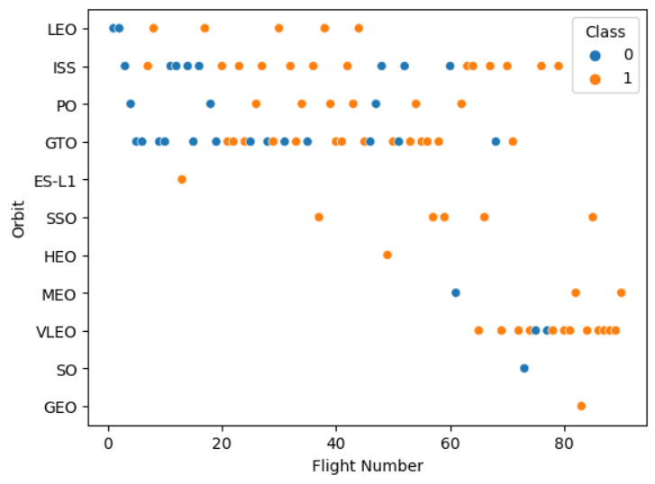
Flight Number vs. Orbit Type
The correlation between orbit preferences and launch outcomes could be influenced by Flight number.
SpaceX's ability to adapt its launch strategies and achieve better results in certain orbit can be seen here with the missions in VLEO having a high success rate considering the sample size.

Slide 22
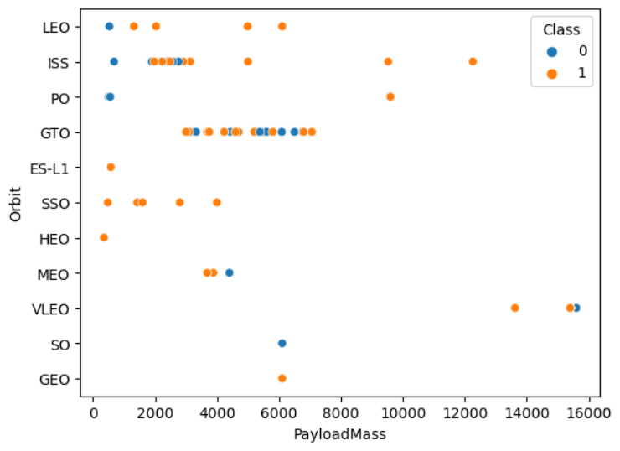
Payload vs. Orbit Type
SSO orbit has all payload mass less than 5000
ISS, PO and VLEO are the only orbits that have payload mass greater than 10000
GTO has all payload mass within the range 0f 3000 to 8000. However, it’s difficult to determine their payload mass and success rate.

Slide 23
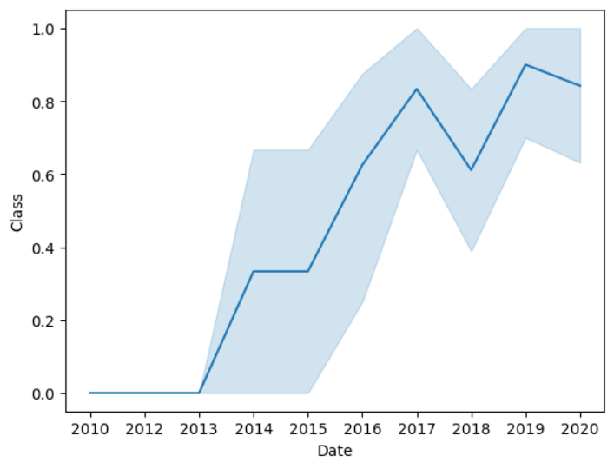
Launch Success Yearly Trend
Since 2013, there has been a progressive increase in the success rate
There was a decline in the success rate in 2018 and a minor dip around 2020.

Slide 24
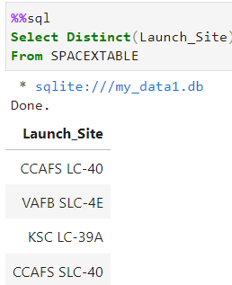
All Launch Site Names
CCAFS LC-40, VAFB SLC-4E, KSC LC-39A, and CCAFS SLC-40 are the four unique launch sites.

Slide 25
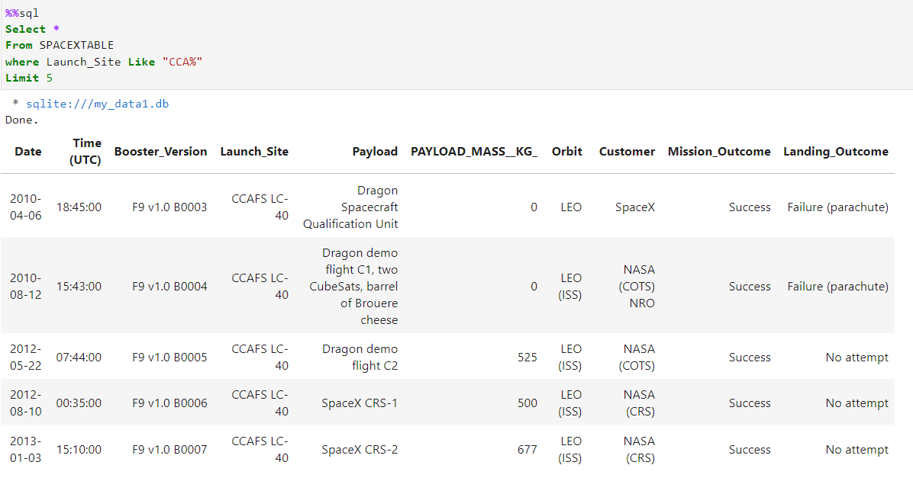
Launch Site Names Begin with 'CCA'
5 records where launch sites begin with `CCA`

Slide 26
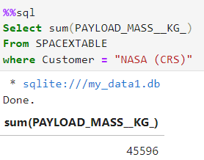
Total Payload Mass
The total payload carried by boosters where NASA was the customer

Slide 27
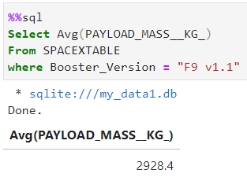
Average Payload Mass by F9 v1.1
The average payload mass for all missons carried by booster version F9 v1.1

Slide 28
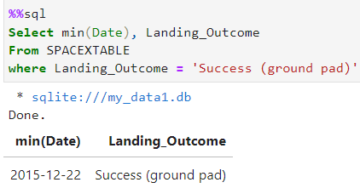
First Successful Ground Landing Date
The dates of the first successful landing outcome on ground pad
This is the first successful ground pad landings not the earliest successful landing

Slide 29
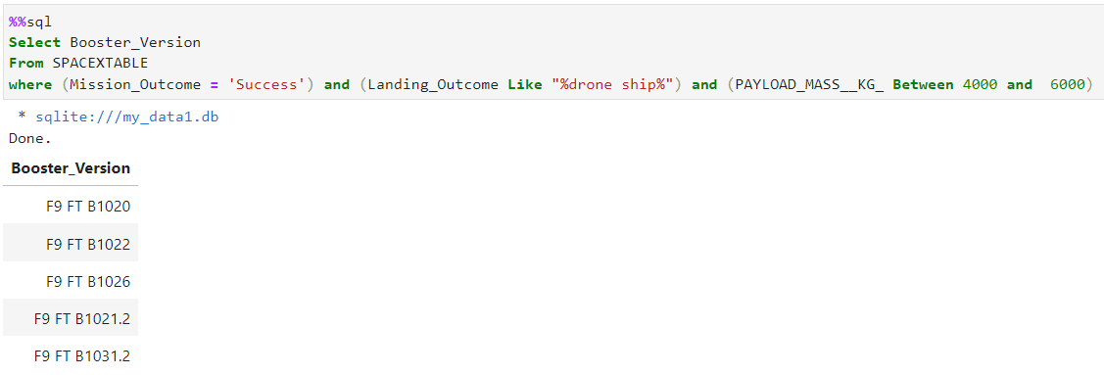
Successful Drone Ship Landing with Payload between 4000 and 6000
There are five booster versions which have successfully landed on drone ship and had payload mass greater than 4000 but less than 6000

Slide 30
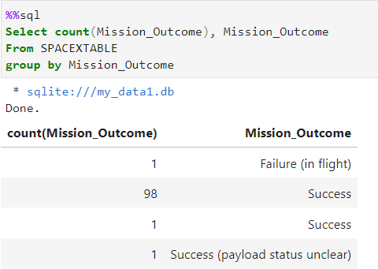
Total Number of Successful and Failure Mission Outcomes
The total number of successful and failure mission outcomes
There is a 99% success rate for all missions carried out by SpaceX

Slide 31
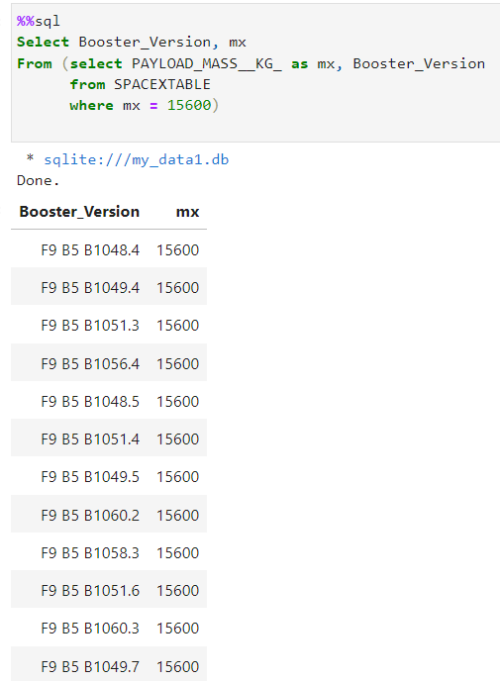
Boosters Carried Maximum Payload
The names of the booster which have carried the maximum payload mass
Booster versions of the ‘F9 B5 B10s’ have the heaviest payload.

Slide 32
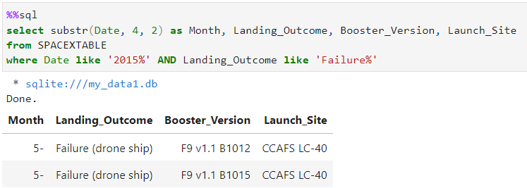
2015 Launch Records
The failed landing_outcomes in drone ship, their booster versions, and launch site names for in year 2015
In 2015 there were only two failed landings in drone ship which were both from launch site CCAFS LC-40

Slide 33
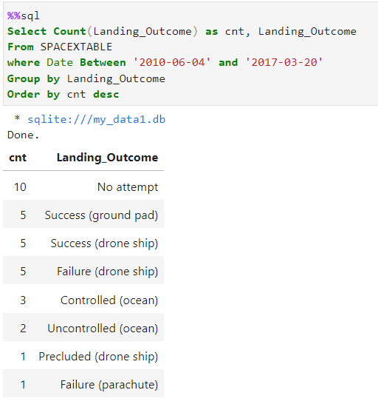
Rank Landing Outcomes Between 2010-06-04 and 2017-03-20
Ranking the count of landing outcomes (such as Failure (drone ship) or Success (ground pad)) between the date 2010-06-04 and 2017-03-20, in descending order
Between this time period there were 10 successful landings, 10 no attempt and 6 failed landings.

Slide 34

Section 3

Slide 35
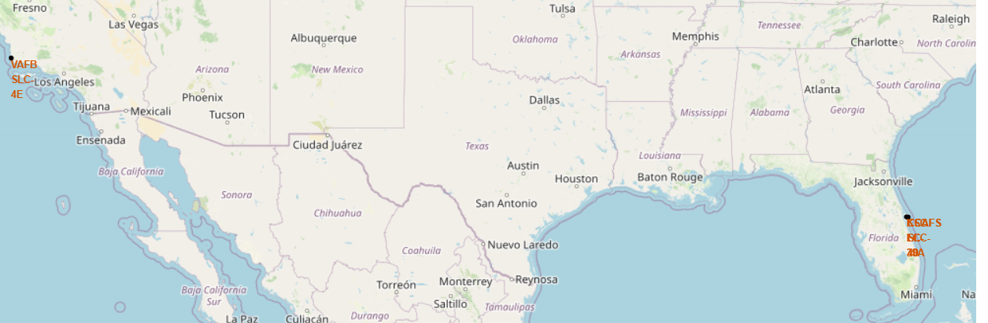
Location of Launch Sites
The Launch sites are located in California and Florida.
We can observe all the launch sites are located near the coastline.

Slide 36
Launch Markers
The red markers represent “Class = 0” meaning unsuccessful launch, vice versa the green marker represent “Class = 1” meaning successful marker
Marker cluster are used here to help handle multiple markers with the same coordinates.
Here, CCAFS SLC-40 shows 19 landings and 7 successful landings.

Slide 37
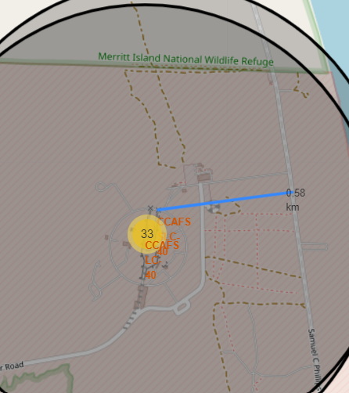
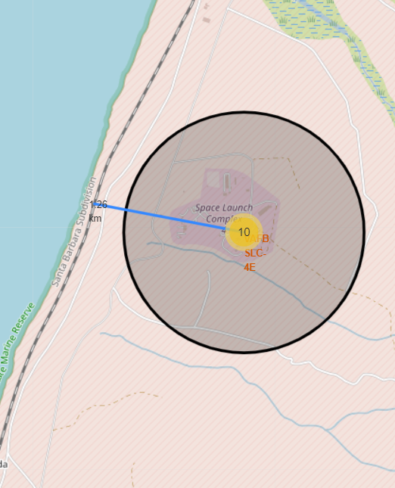
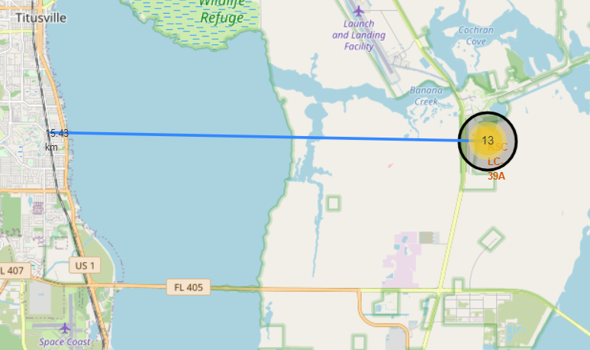
Proximities of Launch Sites
The lines draw here connects launch sites to highway, railway, and city.
KSC LC-39A seems to be the launch site closest to a city. However, all launch site have two or more transportation route close by.

Slide 38

Section 4

Slide 39
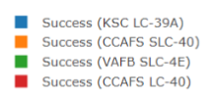
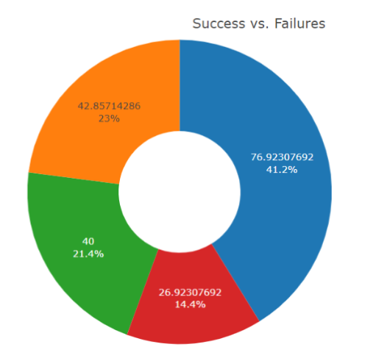
Successful Launch For All Sites
This pie chart represent the distribution of successful landings for all launch sites.
Given the sample sizes KSC LC-39A has the highest share of success rate
VAFB SLC-4E has the lowest share landings success rate

Slide 40
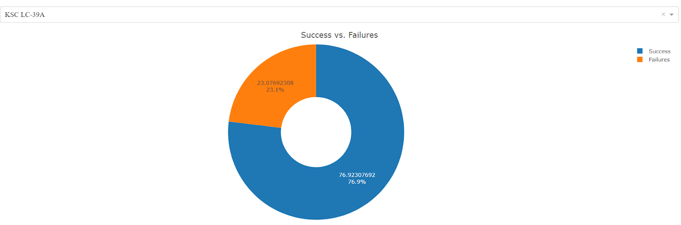
Highest Launch success ratio
KSC LC-39A has the highest success rate landings of 76.9% for all outcomes.

Slide 41

Payload vs Launch Outcome
Launch outcome = 1 represents a successful outcome, and launch outcome = 0 represents failed outcomes.
Booster Version v1.0 and v1.1 have the most unsuccessful launch outcomes, whereas ‘FT’ boosters have the most successful outcomes.

Slide 42

Section 5

Slide 43
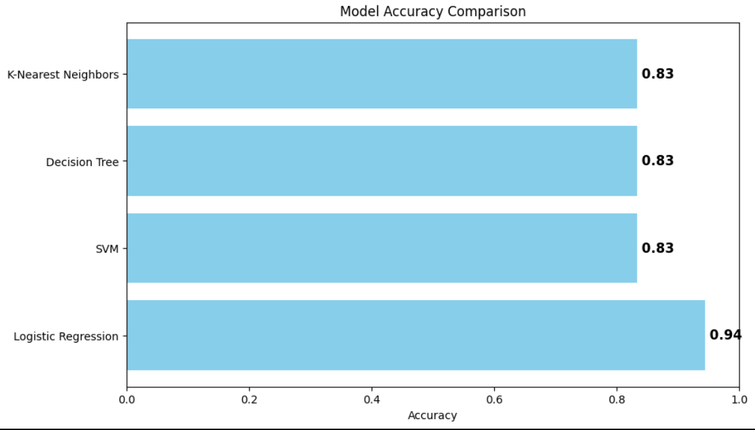
Classification Accuracy
This bar chart compares the accuracy of the four models using their score.
Logistic regression has the highest test accuracy of 94% making it better for predicting landing outcomes.

Slide 44
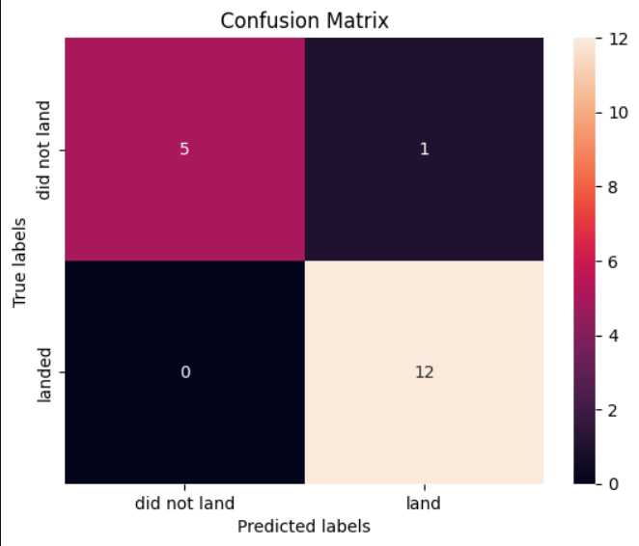
Confusion Matrix
This is the confusion matrix of the best performing model (logistic regression)
From the confusion matrix, we can see that the model predicted 5 failed landings correctly and 1 incorrectly.
The model had a 100% accuracy in predicting 12 successful landings and 0 incorrectly.
Show the confusion matrix of the best performing model with an explanation

Slide 45
Conclusions
Given the data, the objective to determine if the first stage of a falcon 9 launch will land successfully was explored in-depth.
From the plotly dash, the interactive components provide users with insights into SpaceX launch records, helping them explore success rates, payload effects, and launch sites' performance
Performed grid search cross-validations to determine the hyperparameters for all models helped to determine the best performing model (logistic regression with a 94% accuracy)for predicting landing outcomes.
The limitations with this project is that the models were trained on historical data, and real-world conditions may change over time. Additionally, the dataset used for training and testing may not capture all relevant factors affecting rocket landings.

Slide 46
Appendix
List of Falcon 9 Launches:
List of Falcon 9 and Falcon Heavy launches – Wikipedia
Github:
Morphy-Yeboah/IBM-Data-Science-Capstone-Project (github.com)
SpaceX API:
https://api.spacexdata.com/v4/launches/past

Slide 47


